Slide 1



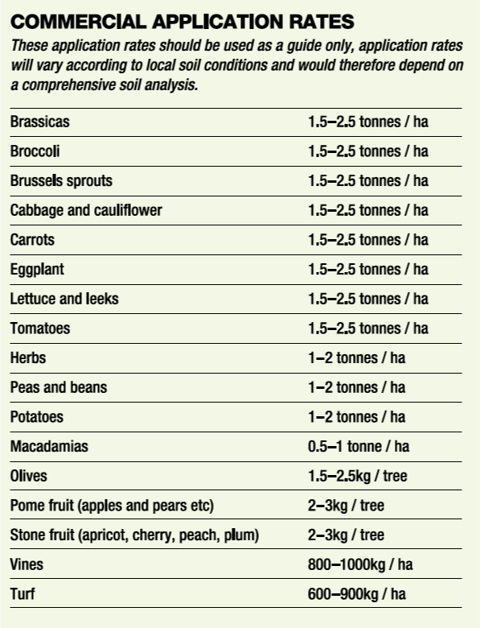
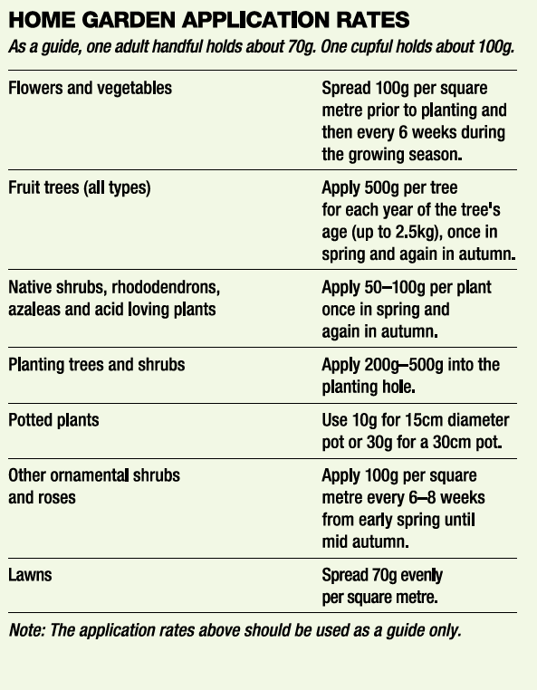
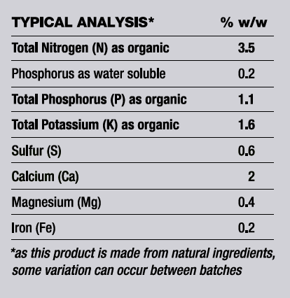
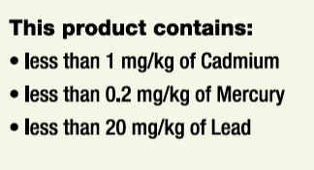
95041
N
3.5
P
1.1
Organic Based Pellets 1000kg
1.6
K
Improves moisture retention and microbial activity
Releases nutrients slowly
Made from composted chicken manure
Yates Australia
1 Gow Street, Padstow NSW 2211 www.ocp.com.au
Product lnformation (Aust): 1300 369 074

Slide 2
95041
N
3.5
P
1.1
K
1.6
Organic Based Pellets 1000kg
PRECAUTIONS
Do not apply when maximum temperature is expected to reach above 30°C or when soil is dry and plants are suffering from moisture stress. Avoid excessive contact with plant foliage.
STORE CLOSED IN A DRY PLACE. KEEP OUT OF REACH OF CHILDREN AND PETS.
PET SAFETY: SOME PETS MAY BE ATTRACTEDTO THIS PRODUCT. STORE OUT OF REACH OF PETS. TO PREVENT CONSUMPTION AFTER APPLICATION, RAKE PELLETS INTO TOPSOIL AND WATER WELL.
HEALTH WARNING: ORGANIC FERTILISERS CONTAIN MICRO-ORGANISMS THAT MAY BE HARMFUL TO YOUR HEALTH. DO NOT SWALLOW. THE DUST FROM THIS PRODUCT MAY ACT AS AN IRRITANT. AVOID INHALATION AND CONTACT WITH THE EYES AND SKIN. WEAR PARTICULATE MASK IF DUSTY. WEAR GLOVES WHEN HANDLING AND WASH HANDS IMMEDIATELY AFTER USE.
This product contains restricted animal material
DO NOT FEED TO CATTLE, SHEEP, GOATS, DEER, ALPACA OR OTHER RUMINANT ANIMALS. DO NOT APPLY WHERE RUMINANT ANIMALS ARE GRAZING. ALWAYS CULTIVATE INTO THE SOIL AND WATER WELL. ALLOW AT LEAST 3 WEEKS BEFORE ALLOWING RUMINANTS TO ENTER AREA.
FOR EMERGENCIES ONLY, CALL AUSTRALIA 1800 033 111 (ALL HOURS)
®Yates and Dynamic Lifter are registered
trade marks of DuluxGroup (Australia) Pty Ltd.
Yates Australia
1 Gow Street, Padstow NSW 2211 www.ocp.com.au
Product lnformation (Aust): 1300 369 074

