Slide 1


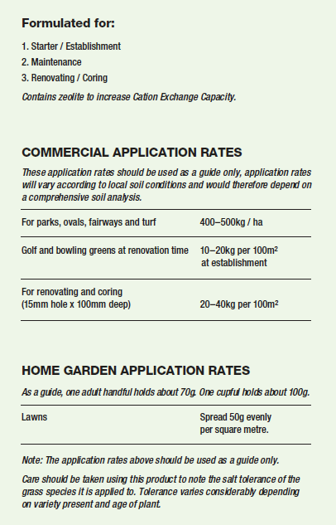
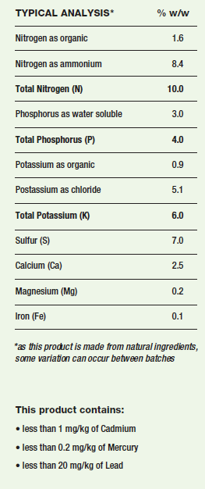
95040
N
10
P
4
Turf Lifter Granules 1000kg
6
K
Unique blend of composted chicken manure and mineral fertilisers
Slow and fast release of nitrogen
Retains moisture and nutrients
Professional turf fertiliser
Yates Australia
1 Gow Street, Padstow NSW 2211 www.ocp.com.au
Product lnformation (Aust): 1300 369 074

Slide 2
95040
N
10
P
4
K
6
Turf Lifter Granules 1000kg
PRECAUTIONS
Do not apply when maximum temperature is expected to reach above 30°C or when soil is dry and plants are suffering from moisture stress. Avoid excessive contact with plant foliage.
STORE CLOSED IN A DRY PLACE. KEEP OUT OF REACH OF CHILDREN AND PETS.
PET SAFETY: SOME PETS MAY BE ATTRACTEDTO THIS PRODUCT. STORE OUT OF REACH OF PETS. TO PREVENT CONSUMPTION AFTER APPLICATION, RAKE PELLETS INTO TOPSOIL AND WATER WELL.
HEALTH WARNING: ORGANIC FERTILISERS CONTAIN MICRO-ORGANISMS THAT MAY BE HARMFUL TO YOUR HEALTH. DO NOT SWALLOW. THE DUST FROM THIS PRODUCT MAY ACT AS AN IRRITANT. AVOID INHALATION AND CONTACT WITH THE EYES AND SKIN. WEAR PARTICULATE MASK IF DUSTY. WEAR GLOVES WHEN HANDLING AND WASH HANDS IMMEDIATELY AFTER USE.
FOR EMERGENCIES ONLY, CALL AUSTRALIA 1800 033 111 (ALL HOURS)
®Yates and Dynamic Lifter are registered
trade marks of DuluxGroup (Australia) Pty Ltd.
Yates Australia
1 Gow Street, Padstow NSW 2211 www.ocp.com.au
Product lnformation (Aust): 1300 369 074

